Slide 1
MACHINE LEARNING
Session – 9
Date – 08th June, 2022

Slide 2
5) Encoding Categorical data:

Slide 3
Encoding Categorical data:
Categorical data is data which has some categories such as, in our dataset; there are two categorical variable, Country, and Purchased.
Since machine learning model completely works on mathematics and numbers, but if our dataset would have a categorical variable, then it may create trouble while building the model. So it is necessary to encode these categorical variables into numbers.
For Country variable:
Firstly, we will convert the country variables into categorical data. So to do this, we will use LabelEncoder() class from preprocessing library.
#Catgorical data
#for Country Variable
from sklearn.preprocessing import LabelEncoder
label_encoder_x= LabelEncoder()
x[:, 0]= label_encoder_x.fit_transform(x[:, 0])

Slide 4
Encoding Categorical data:
Explanation:
In above code, we have imported LabelEncoder class of sklearn library. This class has successfully encoded the variables into digits.
But in our case, there are three country variables, and as we can see in the above output, these variables are encoded into 0, 1, and 2. By these values, the machine learning model may assume that there is some correlation between these variables which will produce the wrong output. So to remove this issue, we will use dummy encoding.
Dummy Variables:
Dummy variables are those variables which have values 0 or 1. The 1 value gives the presence of that variable in a particular column, and rest variables become 0. With dummy encoding, we will have a number of columns equal to the number of categories.
In our dataset, we have 3 categories so it will produce three columns having 0 and 1 values. For Dummy Encoding, we will use OneHotEncoder class of preprocessing library.
#for Country Variable
from sklearn.preprocessing import LabelEncoder, OneHotEncoder
label_encoder_x= LabelEncoder()
x[:, 0]= label_encoder_x.fit_transform(x[:, 0])
#Encoding for dummy variables
onehot_encoder= OneHotEncoder(categorical_features= [0])
x= onehot_encoder.fit_transform(x).toarray()

Slide 5
Encoding Categorical data:
For Purchased Variable:
labelencoder_y= LabelEncoder()
y= labelencoder_y.fit_transform(y)
For the second categorical variable, we will only use labelencoder object of LableEncoder class. Here we are not using OneHotEncoder class because the purchased variable has only two categories yes or no, and which are automatically encoded into 0 and 1.

Slide 6
6) Splitting the Dataset into the Training set and Test set

Slide 7
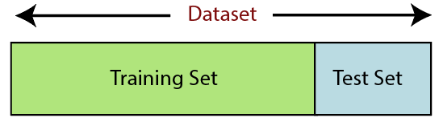
Splitting the Dataset into the Training set and Test set
In machine learning data preprocessing, we divide our dataset into a training set and test set. This is one of the crucial steps of data preprocessing as by doing this, we can enhance the performance of our machine learning model.
Suppose, if we have given training to our machine learning model by a dataset and we test it by a completely different dataset. Then, it will create difficulties for our model to understand the correlations between the models.
If we train our model very well and its training accuracy is also very high, but we provide a new dataset to it, then it will decrease the performance. So we always try to make a machine learning model which performs well with the training set and also with the test dataset. Here, we can define these datasets as:

Slide 8
Splitting the Dataset into the Training set and Test set
Training Set: A subset of dataset to train the machine learning model, and we already know the output.
Test set: A subset of dataset to test the machine learning model, and by using the test set, model predicts the output.
For splitting the dataset, we will use the below lines of code:
from sklearn.model_selection import train_test_split
x_train, x_test, y_train, y_test= train_test_split(x, y, test_size= 0.2, random_state=0)

Slide 9
Splitting the Dataset into the Training set and Test set
Explanation:
In the above code, the first line is used for splitting arrays of the dataset into random train and test subsets.
In the second line, we have used four variables for our output that are
x_train: features for the training data
x_test: features for testing data
y_train: Dependent variables for training data
y_test: Independent variable for testing data
In train_test_split() function, we have passed four parameters in which first two are for arrays of data, and test_size is for specifying the size of the test set. The test_size maybe .5, .3, or .2, which tells the dividing ratio of training and testing sets.
The last parameter random_state is used to set a seed for a random generator so that you always get the same result, and the most used value for this is 42.

Slide 10
7) Feature Scaling

Slide 11
Feature Scaling
Feature scaling is the final step of data preprocessing in machine learning. It is a technique to standardize the independent variables of the dataset in a specific range. In feature scaling, we put our variables in the same range and in the same scale so that no any variable dominate the other variable.
A machine learning model is based on Euclidean distance, and if we do not scale the variable, then it will cause some issue in our machine learning model.

Slide 12
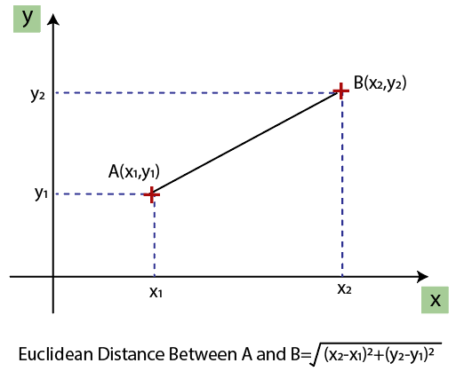
Feature Scaling
Euclidean distance is given as:
If we compute any two values from age and salary, then salary values will dominate the age values, and it will produce an incorrect result. So to remove this issue, we need to perform feature scaling for machine learning.

Slide 13
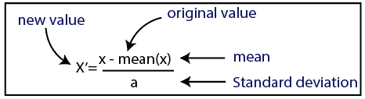
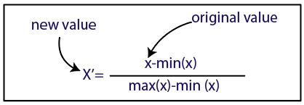
Feature Scaling
There are two ways to perform feature scaling in machine learning:
Standardization
Normalization

Slide 14
Feature Scaling
Here, we will use the standardization method for our dataset.
For feature scaling, we will import StandardScaler class of sklearn.preprocessing library as:
from sklearn.preprocessing import StandardScaler
Now, we will create the object of StandardScaler class for independent variables or features. And then we will fit and transform the training dataset.
st_x= StandardScaler()
x_train= st_x.fit_transform(x_train)
For test dataset, we will directly apply transform() function instead of fit_transform() because it is already done in training set.
x_test= st_x.transform(x_test)

Slide 15
Feature Scaling
Feature scaling is the final step of data preprocessing in machine learning. It is a technique to standardize the independent variables of the dataset in a specific range. In feature scaling, we put our variables in the same range and in the same scale so that no any variable dominate the other variable.
A machine learning model is based on Euclidean distance, and if we do not scale the variable, then it will cause some issue in our machine learning model.

Slide 16
Combining all the steps:

Slide 17
Combining all the steps:
Refer to the Jupyter file named “DataPreprocessing.py”

